Slide 1
CSE303 PROJECT
Analysis of a Restricted Linear Logic
Aarrya Saraf supervised by Dr. Noam Zeilberger

Slide 2
Prerequisites
Linear Ordered Logic
Notes:
Linear logic uses the formula as a resource instead of emphasizing the truth. It being ordered makes sure that if a comes before b in the formula then the same must happen in the proof

Slide 3
Prerequisites
Linear Ordered Logic
For our system we will use only the linear implication (-o)
Notes:
Hence it is equivalent to a binary tree

Slide 4
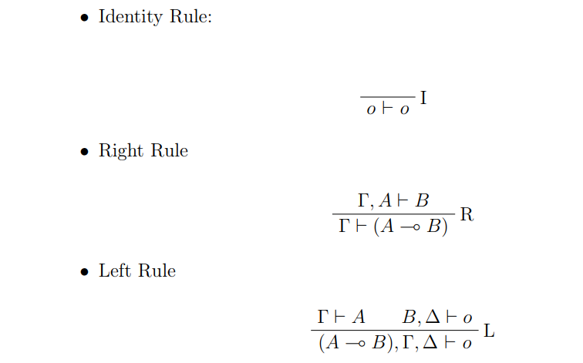
Prerequisites
Linear Ordered Logic
Rules
Notes:
• Small letters are for atomic formulae and hence the identity rule can be applied only to atomic formulae, and before applying the left rule we must ensure the right-hand side is an atom. Furthermore, on the right sequent after the left rule, the right side is always an atom as well. • Our system is ordered and we cannot freely interchange two sequents • This structure also means that at each time we can apply only 1 of the 3 rules and it will always be in the order identity followed by right followed by left recursively until we reach a point where we prove it or are unable to prove it. • A sequent cannot be proved iff no rules can be applied to it. For example o, o ⊢ o and a ⊢ b.

Slide 5
Prerequisites
Linear Ordered Logic
Rules
Atoms
Notes:
• Small letters are for atomic formulae and hence the identity rule can be applied only to atomic formulae, and before applying the left rule we must ensure the right-hand side is an atom. Furthermore, on the right sequent after the left rule, the right side is always an atom as well. • Our system is ordered and we cannot freely interchange two sequents • This structure also means that at each time we can apply only 1 of the 3 rules and it will always be in the order identity followed by right followed by left recursively until we reach a point where we prove it or are unable to prove it. • A sequent cannot be proved iff no rules can be applied to it. For example o, o ⊢ o and a ⊢ b.

Slide 6
Prerequisites
Linear Ordered Logic
Rules
Atoms = small letters
Ordered
Notes:
• Small letters are for atomic formulae and hence the identity rule can be applied only to atomic formulae, and before applying the left rule we must ensure the right-hand side is an atom. Furthermore, on the right sequent after the left rule, the right side is always an atom as well. • Our system is ordered and we cannot freely interchange two sequents • This structure also means that at each time we can apply only 1 of the 3 rules and it will always be in the order identity followed by right followed by left recursively until we reach a point where we prove it or are unable to prove it. • A sequent cannot be proved iff no rules can be applied to it. For example o, o ⊢ o and a ⊢ b.

Slide 7
Prerequisites
Linear Ordered Logic
Rules
Atoms = small letters
Ordered
At most 1 rule
Notes:
• Small letters are for atomic formulae and hence the identity rule can be applied only to atomic formulae, and before applying the left rule we must ensure the right-hand side is an atom. Furthermore, on the right sequent after the left rule, the right side is always an atom as well. • Our system is ordered and we cannot freely interchange two sequents • This structure also means that at each time we can apply only 1 of the 3 rules and it will always be in the order identity followed by right followed by left recursively until we reach a point where we prove it or are unable to prove it. • A sequent cannot be proved iff no rules can be applied to it. For example o, o ⊢ o and a ⊢ b.

Slide 8
Prerequisites
Linear Ordered Logic
Rules
a -o b
Notes:
• Small letters are for atomic formulae and hence the identity rule can be applied only to atomic formulae, and before applying the left rule we must ensure the right-hand side is an atom. Furthermore, on the right sequent after the left rule, the right side is always an atom as well. • Our system is ordered and we cannot freely interchange two sequents • This structure also means that at each time we can apply only 1 of the 3 rules and it will always be in the order identity followed by right followed by left recursively until we reach a point where we prove it or are unable to prove it. • A sequent cannot be proved iff no rules can be applied to it. For example o, o ⊢ o and a ⊢ b.

Slide 9
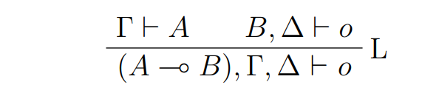
Prerequisites
Linear Ordered Logic
A source of Ambiguity
Notes:
In the left rule we can select delta and lambda

Slide 10
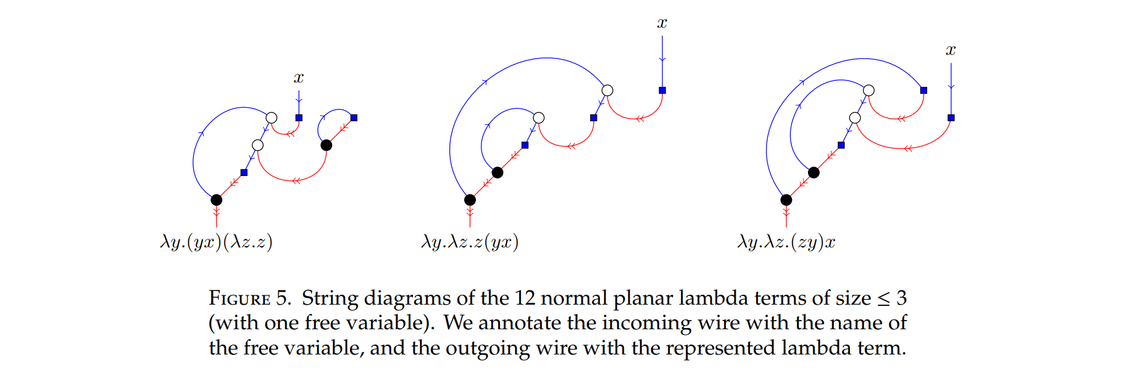
Motivation
An Initial Bijection
Notes:
Discovered by Zeilberger in 2015 it described a correspondence between normal planar lambda terms and rooted planar maps

Slide 11
Motivation
A more “natural” bijection
Notes:
Fang in 2023 has described a bijection which is more natural. In the sense that it relies on proofs in this logic described earlier.
Because of the ambiguity some proofs admit more than 1 proof and we wanted to study why or how. Can we have sufficient/ necessary conditions for a sequent to be provable? For the proof to be unique? All of this to further uncover the bijection

Slide 12
The System
In Haskell
Notes:
Since the logic system is so simple we could easily make a system which takes in a sequent and says whether it is provable or not. We just 1 by 1 try the rules and if we reach the identity rule we are done. However, if we cannot apply any rule it is not provable. We need to do this for every possible value of delta and gamma.

Slide 13
The System
The Prover
Notes:
Since the logic system is so simple we could easily make a system which takes in a sequent and says whether it is provable or not. We just 1 by 1 try the rules and if we reach the identity rule we are done. However, if we cannot apply any rule it is not provable. We need to do this for every possible value of delta and gamma.

Slide 14
The System
The Prover
The sequent generator
Notes:
Since the logic system is so simple we could easily make a system which takes in a sequent and says whether it is provable or not. We just 1 by 1 try the rules and if we reach the identity rule we are done. However, if we cannot apply any rule it is not provable. We need to do this for every possible value of delta and gamma.

Slide 15
The Prover
Gives 0 if not provable and n the number of proofs if provable
Notes:
Because of lazy evaluation and pattern matching

Slide 16
The Sequent Generator
Sequents = Binary trees
Notes:
As mentioned earlier sequents are just like binary trees.

Slide 17
The Sequent Generator
Sequents = Binary trees
a -o a
Notes:
As mentioned earlier sequents are just like binary trees.

Slide 18
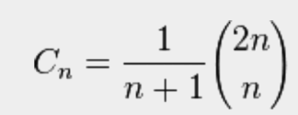
The Sequent Generator
Sequents = Binary trees
Catalan Numbers
Number of binary trees of size n
1, 1, 2, 5, 14, 42, 132, 429, 1430, 4862, 16796, 58786

Slide 19
The Sequent generator
Generating atoms
Notes:
The sequents might have different atoms. We have just looked at the structure and size till now.

Slide 20
The Sequent generator
Generating atoms
Initial Approach
Notes:
Problem

Slide 21

The Sequent generator
Generating atoms
Initial Approach: Generating duplicates
A -o A
B -o B
Also
Notes:
Problem

Slide 22
The Sequent generator
Solution: Partitioning the Sets
Notes:
Instead we could try all possible partitions for the set and assign different atoms to each partition

Slide 23
The Sequent generator
Solution: Partitioning the Sets
[1,2,3]
[1,2],[3]
[1],[2,3]
[1,3],[2]
[1],[2],[3]
Notes:
Instead we could try all possible partitions for the set and assign different atoms to each partition

Slide 24
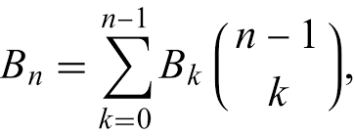
The Sequent generator
Solution: Partitioning the Sets
Bell Numbers
1, 1, 2, 5, 15, 52, 203, 877, 4140

Slide 25
Key observations
The proofs depend on the following factors
Size of the sequent (total number of atoms)
Notes:
If odd then 0 if not then increases

Slide 26
Key observations
The proofs depend on the following factors
Size of the sequent (total number of atoms)
Number of distinct atoms
Notes:
If any of them appears an odd number of times then 0. If greater than size/2 then 0. But number of sequents increase otherwise and so does the number of proofs.

Slide 27
Key observations
The proofs depend on the following factors
Size of the sequent (total number of atoms)
Number of distinct atoms
Structure of the tree
Notes:
Some structures can never be provable for some configurations

Slide 28
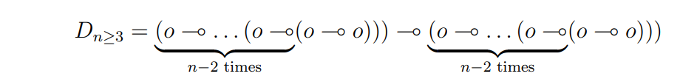
Key observations
The proofs depend on the following factors
Size of the sequent (total number of atoms)
Number of distinct atoms
Structure of the tree
Notes:
Some structures can never be provable for some configurations

Slide 29
Experiments
Notes:
Mainly for verification purpouses

Slide 30
Experiments
Experiment 1
To counter the problem in experiment 1 we fixed the number of distinct atoms to 1 and ran the system. We found the previously found bijection
0, 1, 0, 2, 0, 9, 0, 54, 0, 378, 0, 2916, 0, 24057
Notes:
Mainly for verification purpouses

Slide 31
Experiments
Experiment 2
Summing over all possible proofs over all tree structures and a all atoms for a fixed size. Gives us a sequence dependent on just the size of the sequent.
0, 1, 0, 4, 0, 45, 0, 810…
Notes:
On first look and even at the Online encyclopedia of integer sequences we get nothing but upon further inspection we realise that this is the bell numbers multiplied by our initial sequence which is intuitive

Slide 32
Experiments
Experiment 2
Summing over all possible proofs over all tree structures and a all atoms for a fixed size. Gives us a sequence dependent on just the size of the sequent.
0, 1, 0, 4, 0, 45, 0, 810…
0, 1, 0, 2, 0, 9, 0, 54, 0…
Notes:
On first look and even at the Online encyclopedia of integer sequences we get nothing but upon further inspection we realise that this is the bell numbers multiplied by our initial sequence which is intuitive

Slide 33
Experiments
Experiment 2
Summing over all possible proofs over all tree structures and a all atoms for a fixed size. Gives us a sequence dependent on just the size of the sequent.
0, 1, 0, 4, 0, 45, 0, 810,0…
0, 1, 0, 2, 0, 9, 0, 54, 0…
0,1,0,2,0,5,0,15,0… Bell Numbers again!
Notes:
On first look and even at the Online encyclopedia of integer sequences we get nothing but upon further inspection we realise that this is the bell numbers multiplied by our initial sequence which is intuitive

Slide 34
Experiments
Experiment 2
Number of Proofs:
0, 1, 0, 4, 0, 45, 0, 810,0…
0, 1, 0, 2, 0, 9, 0, 54, 0…
0,1,0,2,0,5,0,15,0
Number of sequents grows by
1,2,5,15…
Notes:
On first look and even at the Online encyclopedia of integer sequences we get nothing but upon further inspection we realise that this is the bell numbers multiplied by our initial sequence which is intuitive

Slide 35
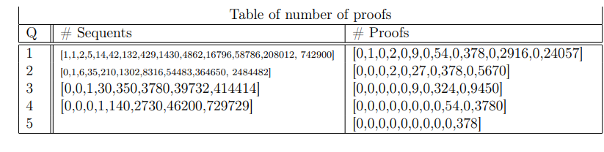
Experiments
Experiment 3
Since 2 gave an interesting result we went deeper.
Notes:
Q here is the number of distinct atoms. Notice that some number of sequents are missing. This is done to reduce computation power and what we did was to remove any sequent which we know is not provable by some trivial test such as an atom appearing an odd number of times

Slide 36
Observations
Diagonals follow the same pattern
For the case of 2 we start multiply the answers for 1 by (2^n) - 1
Looking column wise we actually see the Stirling Numbers of the second kind
Notes:
This is intuitive and confirms what we had thought. In fact a rough proof of it can be seen from a paper stating that every provable sequent is a speacalized version of a balanced sequent. This is in fact a new and interesting observation here.

Slide 37
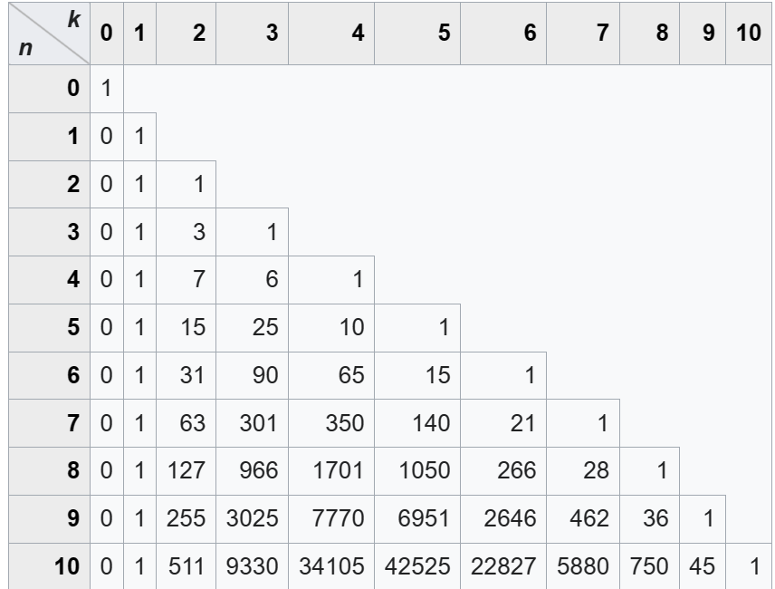
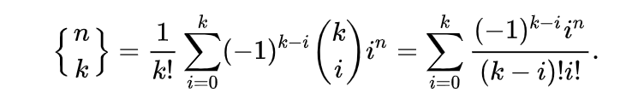
Sterling Numbers
So summing them up will give the Bell Numbers!
Notes:
is the number of ways to partition a set of n objects into k non-empty subsets.

Slide 38
Why?
A proof of a sequent = specialised proof of a balanced sequent.
Notes:
is the number of ways to partition a set of n objects into k non-empty subsets.

Slide 39
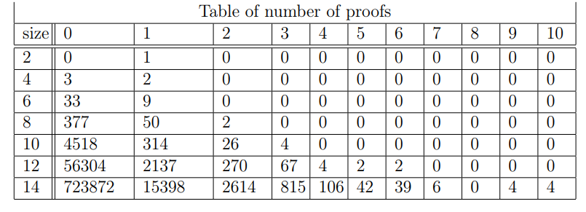
Experiments
Experiment 4
On a similar note this time we fixed the number of distinct atoms and varied the size of the sequent. We noted the number proof possible but did not find anything here
Notes:
We tried to go further into detail here. The columns are the number of proofs. The rows represent the size of the sequent

Slide 40
Future Experiments

Slide 41
Future Experiments
Experiment 5
Fixing the tree structure

Slide 42
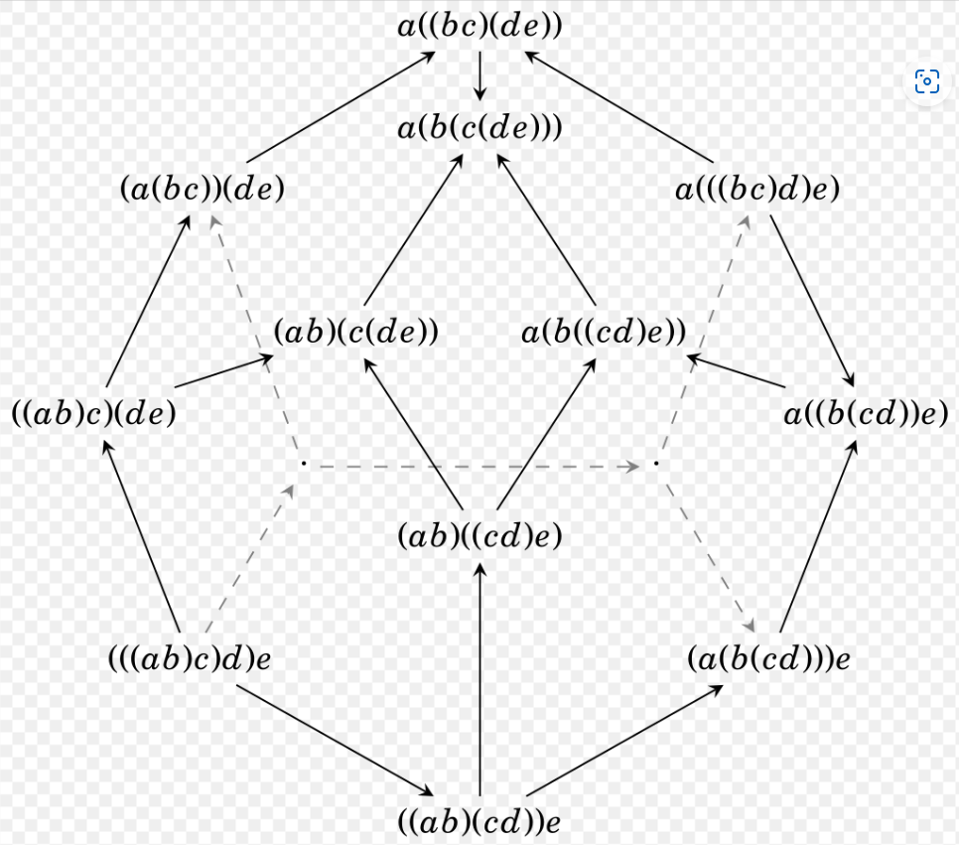
Future Experiments
Experiment 5
Fixing the tree structure

Slide 43
Conclusions
We can now generate all the formulae

Slide 44
Conclusions
We can now generate all the formulae
We can then check if they are true or false (provable or not)

Slide 45
Conclusions
We can now generate all the formulae
We can then check if they are true or false (provable or not)
If yes then have the number of proofs

Slide 46
Conclusions
We can now generate all the formulae
We can then check if they are true or false (provable or not)
If yes then have the number of proofs
Based on this we conducted experiments by fixing various structures

Slide 47
Conclusions
We can now generate all the formulae
We can then check if they are true or false (provable or not)
If yes then have the number of proofs
Based on this we conducted experiments by fixing various structures
We found interesting correspondences between based on varying the number of atoms to what was previously known

Slide 48
Conclusions
We can now generate all the formulae
We can then check if they are true or false (provable or not)
If yes then have the number of proofs
Based on this we conducted experiments by fixing various structures
We found interesting correspondences between based on varying the number of atoms to what was previously known
There are a lot of future experiments that can be conducted much easier with the tools we created and this should help us understand the intriguing bijection

Slide 49
Thank You!

